Slide 1
How to prepare for exam
Darina Polishchuk
Form 11A
School №1

Slide 2
Nothing instills fear and anxiety in the minds of students like a big test. Wanting to study is one thing, but it can be difficult to without the proper guidance. It's important to build good study skills early in your schooling career--skills which will carry you throughout. Fortunately, studying is an issue faced at all levels of school by all students, so you can find help. Read below the jump to get started.

Slide 3
Steps
1. Calm down. Keep in mind that if you have a decent attendance rate, and did a reasonable job doing your assignments, you actually have a lot of knowledge already. This main knowledge will help you throughout your test.
Don't panic. Panic will only make your situation worse. You will be focusing on the horror, and not the upcoming test. Many times, panic can even deter your chances of doing well on the exam. If you panic, take deep breaths (try not to hyperventilate), and think that you can do this.
You're smart enough to realize you need to study days in advance. While some people study the day before, and some people always study this way, realize that last-minute cramming is not the ideal way to study, especially not for the sake of long-term retention of the subject matter. Also make sure not to study too much! Take some breaks for about 5-15 minutes.

Slide 4


Slide 5
2. Determine what material needs to be covered. Most exams cover specific subjects and material, and it's important to know which material or components you need to study. Otherwise, you may be using your precious remaining study time incorrectly. Ask your teacher about the subjects you'll be tested on and which chapters you need to cover. For example: What period in African history? Are diagrams important? Ask your teacher if you're unclear, as they want you to succeed.Study the most important topics first. Exams usually cover a few core ideas, concepts, or skills. When pinched for time, focus your energies on the very important bits you'll be tested on, rather than scattering your studies everywhere. Review sheets, the highlighted topics in textbooks, and the parts your teacher stressed repeatedly are all clues as to what the most important topics or components are.
Find out how the test will be presented. What types of questions will be on it (multiple choice, essay, word problem, etc.)? Find out how much each section is worth. If you do not know, ask the teacher. This will help you know what the most important sections will be, and how the exam will be presented.

Slide 6


Slide 7
3. Make a study plan. It may seem like a basic and simple task, but people who make a detailed study plan often have an easier time with studying and they find they have more time to relax and chill. When making a study plan, build in the amount of time you have left before the exam date. Is the exam in a month? Did the teacher spring the test on you suddenly? Is it a mid year exam that has been building since the start of the year? Depending on the time frame, make your study plan long or short.
Determine what subjects you don't know as much about and include more study sessions on these topics. The aspects you know more about still need reviewing, but they will come easier, so try to focus on the more challenging topics.
Plan your time. It's tempting to put everything off until the night before the test. Instead, figure out how much time you will put aside each day for study. Remember to account for breaks. A good rule is: study for a half-hour, have a break for ten minutes.

Slide 8


Slide 9
4. Figure out your study methods. Study methods include using colors, pictures and brainstorm or mind map pages. Some people learn and remember things better if they're in certain colors whereas other people may remember diagrams and pictures more easily. Use the method that works for you; as long as it's effective, it doesn't matter what it is. It's no use reading a ton of text if your study method is diagrams. Remember, everyone has different methods to study, what works for your best friend may not work for you. Use tools that will help you to study. Tools like flash cards may be boring, but really help memorize important things. If flash cards don't seem to help, typing out an outline of your notes may work.
Tape flash cards in random places to quiz yourself. This is a good way to sneak in study time, as discussed below.
Remember to study smarter, not harder.

Slide 10
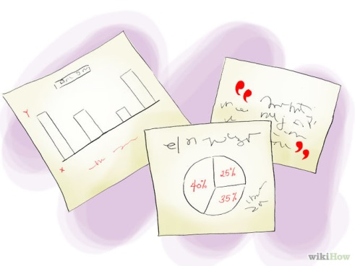

Slide 11
5. Take notes and ask questions. It's never too late, and the sessions before the exam are usually for review, which is just what you need. If you're studying and happen to come across a part you can't understand, write it down. Ask your teacher either during class or during office hours. And don't worry – you aren't dumb if you ask questions. Questions mean that you're actively paying attention, and you're learning. Besides, a question ahead of time could mean a better grade on the exam.

Slide 12


Slide 13

6. Find your resources. Your textbook, notes, online sources, classmates, teachers, and possibly your family members can all be of use. Old assignments are especially good, as some exams have questions directly off homework.

Slide 14
7. Ask for help. You don't get bonus points for doing it alone. Classmates can be helpful in studying, but choose someone who will really help you, not the friend you tend to goof off with. Ask help from your parents or siblings; they may really appreciate being asked. Younger siblings especially like "quizzing" older brothers or sisters!
Form a study group. Not only do you have additional help, you also have the advantage of studying with people you know well. However, avoid accepting those that will be of no help, and only distract your whole group from studying. Don't be rude and reject everyone whom you don't like, but do be cautious about who you add to your study group!

Slide 15


Slide 16
8. Memorize as much as possible. The key to top performance is the ability to memorize all relevant materials. There are tricks for helping to memorize, otherwise called mnemonics. These can include, for instance, poetic or rhyming mnemonics for the auditory learner, visual imagery and fantasy for the visual learner, dance or movement for the kinesthetic learner (as muscles have memory), or some combination. Repetition is another form of memorization that is most commonly used. It allows for high recall if practiced in regular intervals. Practice it even beyond the point at which your memory recall is instantaneous, because this serves as a form of reinforcement.
A common mnemonic is HOMES for the Great Lakes. Another one is drawing stick figures to represent vocabulary words (like a good reason for drawing cartoons!). Create your own mnemonics that suit your needs.
Try rewriting down your notes to study. This is an effective way to memorize.

Slide 17


Slide 18

9. Sneak in study time. Short, repeated periods of study are often more effective than long periods of study. Go over your flash cards while waiting for the bus. Look over a diagram of the spleen while waiting for your breakfast. Read an important quote from "Macbeth" while brushing your teeth. Review the information during study halls or extra time at lunch.

Slide 19

10. Reward yourself. It can help to have a reward to strive for in meeting your goal. Have rewards in place for study milestones and for achieved results, in increasing value to you.

Slide 20
11. Organize yourself for the test. Be sure you have what you need for the test the night before. If you need a No. 2 pencil, a calculator, a German dictionary, or any other supplies, you must have them. The more put-together you are, the calmer you will be, and the more likely you will do well. Be sure your alarm clock is set, so you won't oversleep.
If you're allowed to take food in, take some jelly babies for a sugary hit, but it's best to stick to healthy fruit and vegetables. Apple or carrots make an easy snack that will help replenish your brain power.
Take a bottle of water with no stickers or labels (these could raise suspicions that you're hiding answers on them).

Slide 21


Slide 22
12. Eat properly. Good nutrition is vital for optimal thinking. Try to stay away from high sugar and fatty foods such as ice-cream and cookies. Replace sweet sugary drinks with a cool glass of water or a fresh juice or milk.
Have a "brain" meal the night before. Fish makes a great meal the night before, as it is nutrition for your brain. Try eating some fresh vegetables and pasta with the fish.
Eat a good breakfast. It will keep your mind alert. An example of a good breakfast is a glass of juice, an egg, toast, and cheese. If you do have to eat a bowl of cold cereal, make sure it's wholesome and whole-grain, not a sugary brand, or you may experience a 'crash' during the test.
Avoid drinking coffee, as this will only keep you up and provide you a sugar rush. Once the caffeine has worn out, you won't be able to keep your eyes open. Taking a test while you're drowsy is a no-no, so avoid intake of caffeine or any other foods too close to bedtime. All that digesting will keep you awake at night.
Be careful about making any abrupt eating changes; eat what you would normally eat on a regular school day in order to not disrupt your digestive patterns.

Slide 23
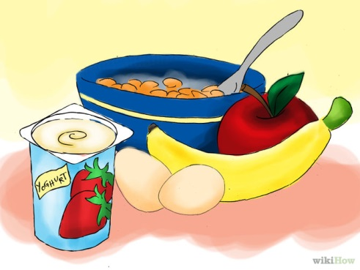

Slide 24
13. Get enough sleep before the big day. This step is extremely important and cannot be skipped. Without sleep, your chances of doing well on the test quickly lower, because your brain can't focus on what it needs to.
If you can't get to sleep, try some warm milk or tea, but be sure there is no caffeine in your drink!
Do not alter your sleeping patterns. Go to sleep at your regular time in order to keep your sleeping patterns regular.

Slide 25


Slide 26
14. Turn up ready for the test. Set your alarm clock in the morning; arrive on time or even a few minutes early. If it's a test that requires registration, fees, identification and the like, schedule extra time for that.
Keep a positive attitude! Studying lots, but thinking you can't really ace that exam, will reduce your chances of succeeding. See yourself as acing it, relying on all the preparation and attention you've given your studies to this point. Confidence is the key!
Aim high. Don't just aim to pass the test (if passing the test is quite easy), aim to get an A+. This way, you get a better grade. Plus, if you don't do as well on the next test, your A+ will still keep your overall grade high enough.

Slide 27
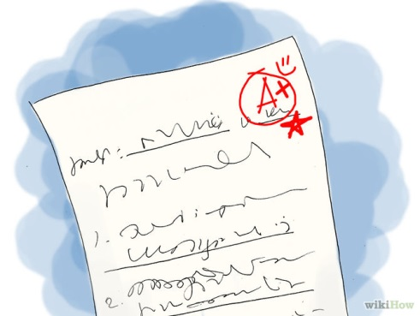

Slide 28
Thank for your attention!

